Slide 1
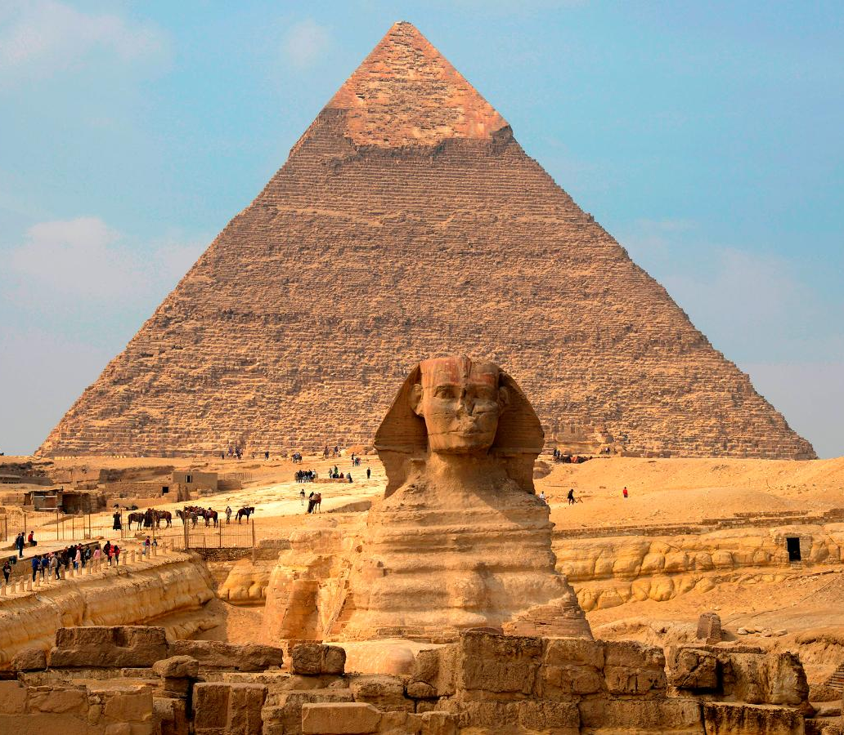
Egyptian Burials
GOAL/S: Outline Ancient Egyptian Burial techniques and afterlife beliefs
Week 7, Lesson 2

Slide 2
Imagine you are an archaeologist discovering a hidden tomb in Egypt.
DISCUSSION: What do you think you would find inside?"

Slide 3
Importance of Burials
Burials were crucial in Ancient Egyptian culture.
Believed to ensure safe passage to the afterlife.
Tombs filled with items needed for the next world (food, treasures, amulets).
Mummification preserved the body for the afterlife.
Involved removing internal organs, drying the body, and wrapping in linen.
Key steps:
Evisceration: removing internal organs (except the heart).
Natron: body dried with a natural salt.
Wrapping: body wrapped in linen strips with amulets placed between layers.

Slide 4
Mummification
https://www.youtube.com/watch?v=9gD0K7oH92U&ab_channel=TED-Ed

Slide 5
Mummification
Belief that preserving the body was essential for the soul's survival.
Mummification allowed the deceased to be recognized in the afterlife.
Protected the body from decay, symbolizing eternal life.

Slide 6
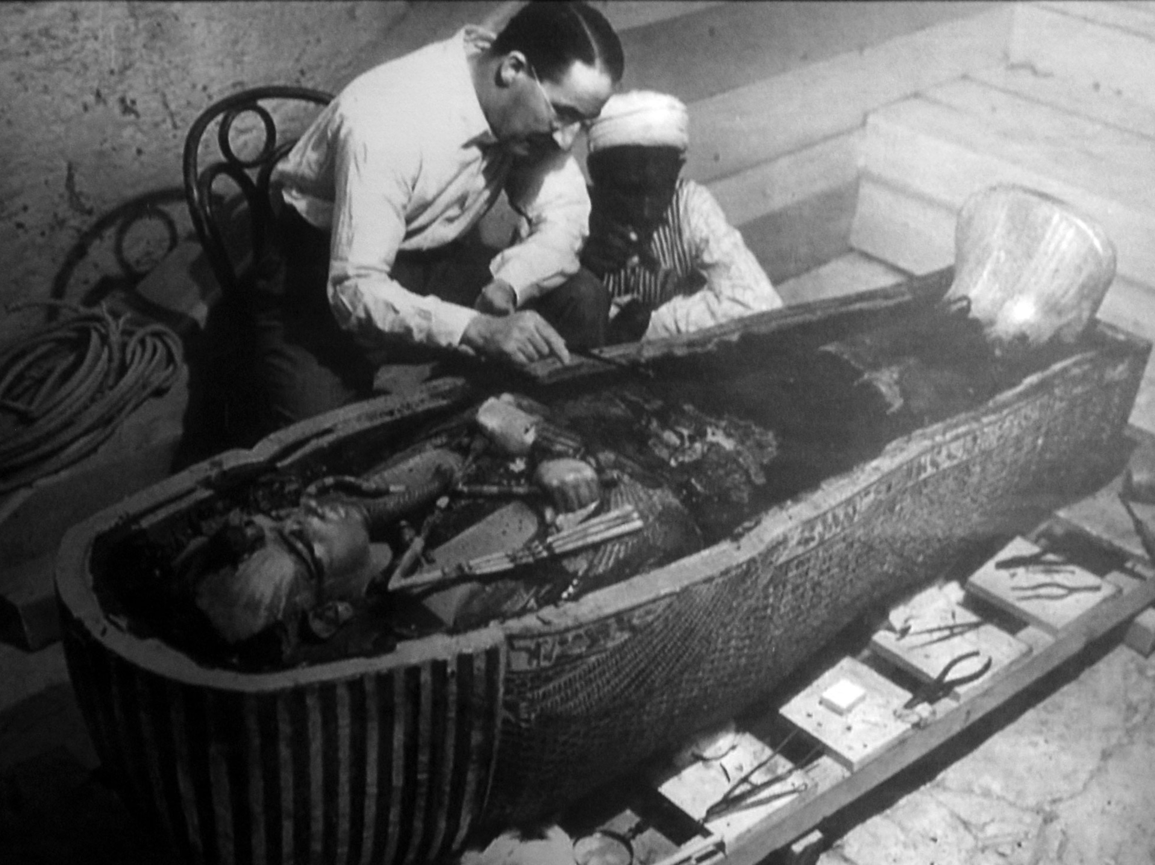
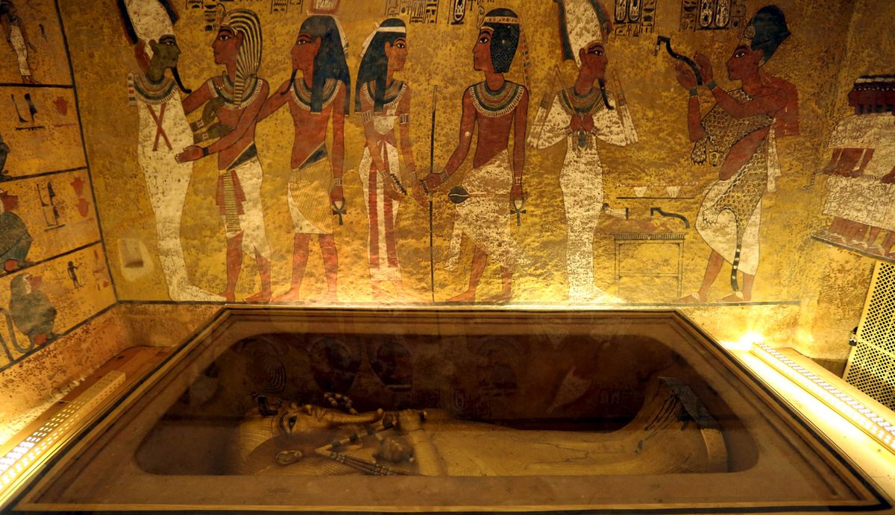
Tutankhamun's Tomb: Discovered in 1922 by Howard Carter. Rich with treasures and artifacts.

Slide 7
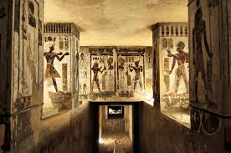
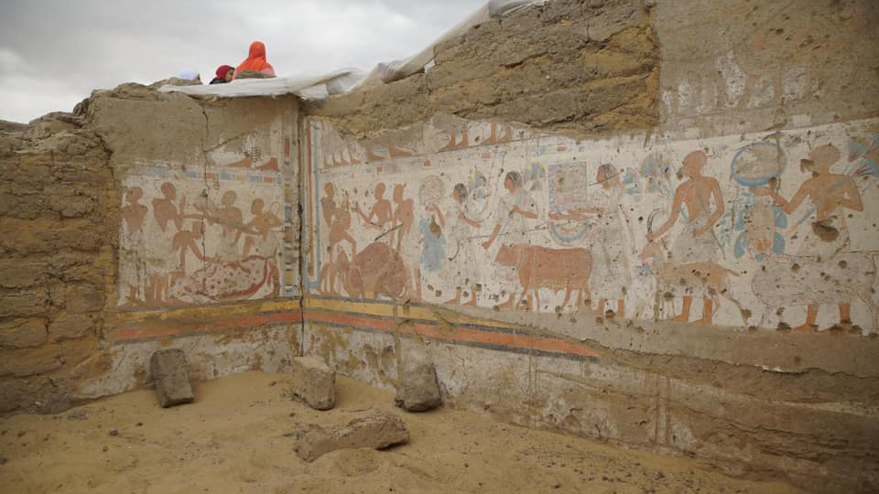
Ramses II: One of Egypt's greatest pharaohs. His well-preserved mummy was found in the Valley of the Kings.

Slide 8
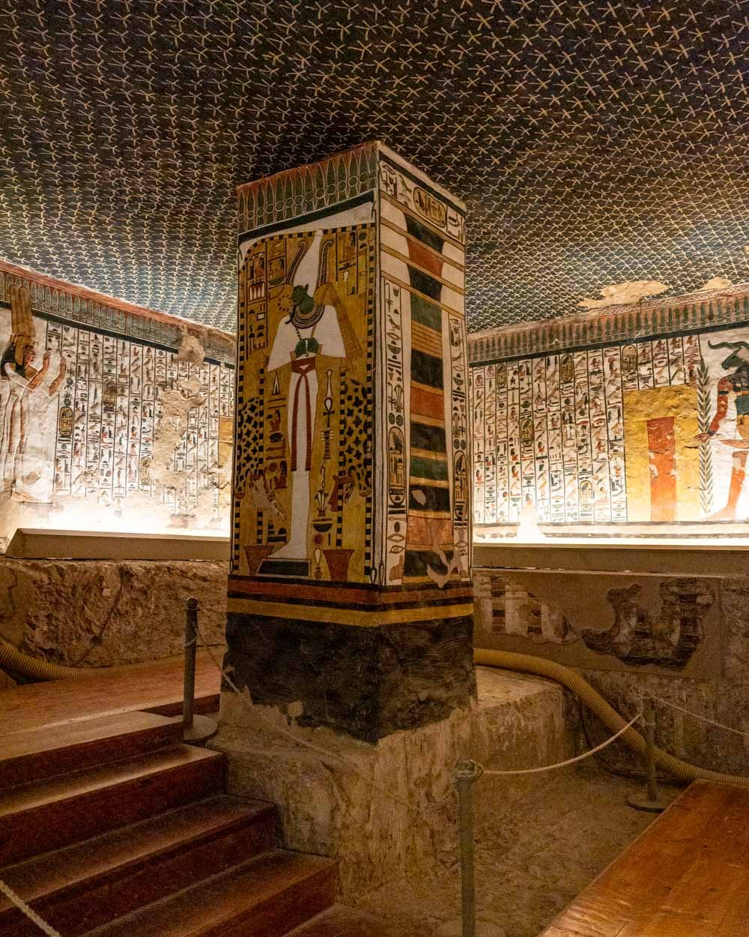
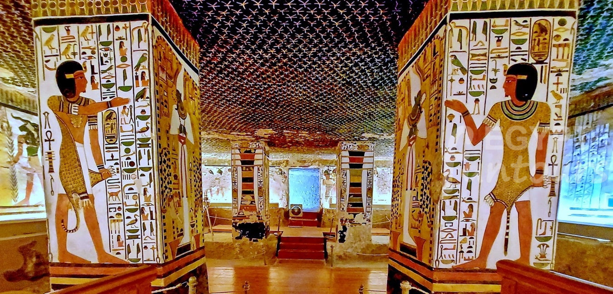
Queen Nefertari: Her beautifully decorated tomb in the Valley of the Queens is famous for its stunning wall paintings.

Slide 9
The Concept of the Soul
Ancient Egyptians believed in a life after death, where the soul would journey to the afterlife.
The afterlife was considered a continuation of one's earthly life, but in an idealized form.
Ka (spirit): Vital essence that stayed near the body; needed offerings to survive.
Ba (personality): Unique characteristics of the individual; depicted as a bird with a human head.
Akh (immortal self): The transformed, glorified state of the soul; achieved after successful journey through the underworld.

Slide 10
The Underworld/Afterlife
The journey through the underworld was fraught with challenges.
The deceased needed to navigate through various gates and face trials to reach the Field of Reeds, the idealized version of Egypt.
The Book of the Dead: A collection of spells, prayers, and incantations designed to help the deceased navigate the afterlife.
Personalized for each individual; placed in the tomb with the mummy.
The Weighing of the Heart Ceremony
Central event in the afterlife journey; depicted in the Book of the Dead.
The heart of the deceased was weighed against the feather of Ma'at (truth and justice).
If the heart was lighter, the soul was granted eternal life. If heavier, it was devoured by Ammit, the soul-eating demon.

Slide 11
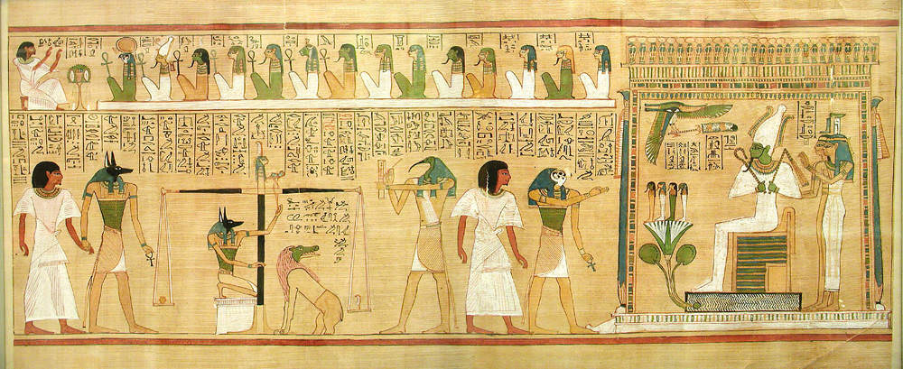
Weighing the Heart – The Book of the Dead

Slide 12
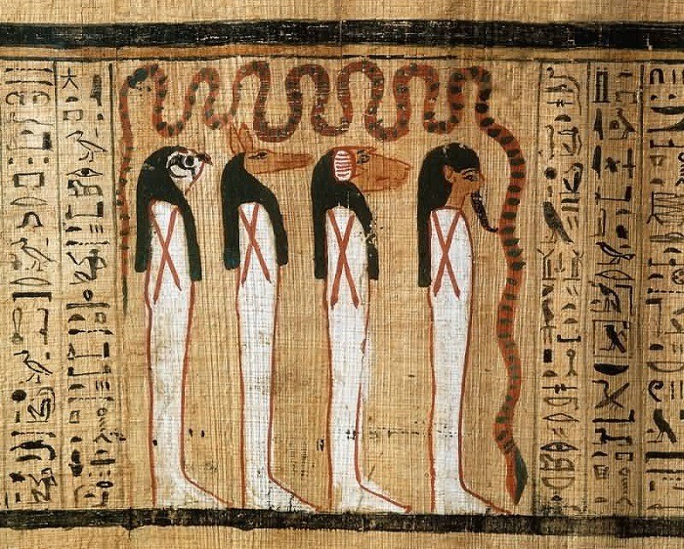
The four sons of Horus From right to left: Imsety, Hapi, Duamutef and Qebehsenuef Personifications of the four canopic jars, which accompanied mummified bodies
– The Book of the Dead

Slide 13
Canopic Jars
Canopic jars were used to store and preserve the internal organs of the deceased during mummification.
Each jar held a specific organ and was associated with one of the four sons of Horus, who protected the contents.
The Four Canopic Jars – the Sons of Horus
Imsety: Human-headed jar, protected the liver.
Hapy: Baboon-headed jar, protected the lungs.
Duamutef: Jackal-headed jar, protected the stomach.
Qebehsenuef: Falcon-headed jar, protected the intestine
Essential for ensuring the deceased could be reborn in the afterlife.
Organs were preserved separately to safeguard the body’s integrity.
Placed in the tomb with the mummy for protection.
Notes:
keh-beh-sen-oof

Slide 14
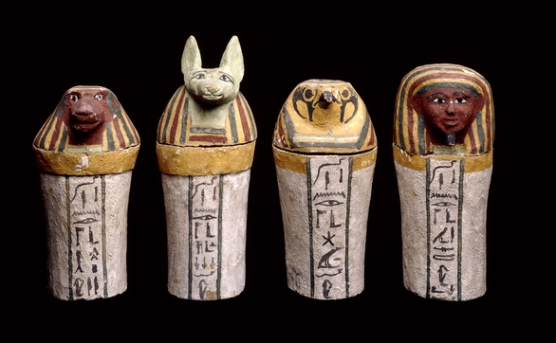
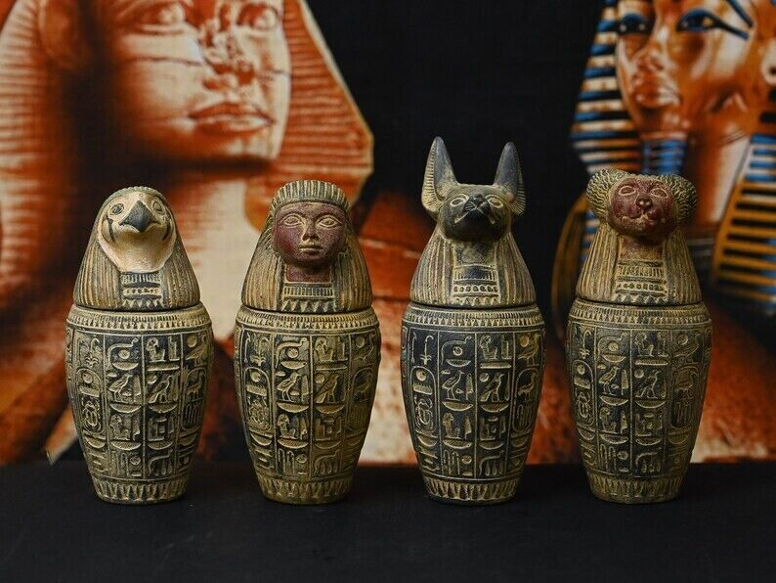
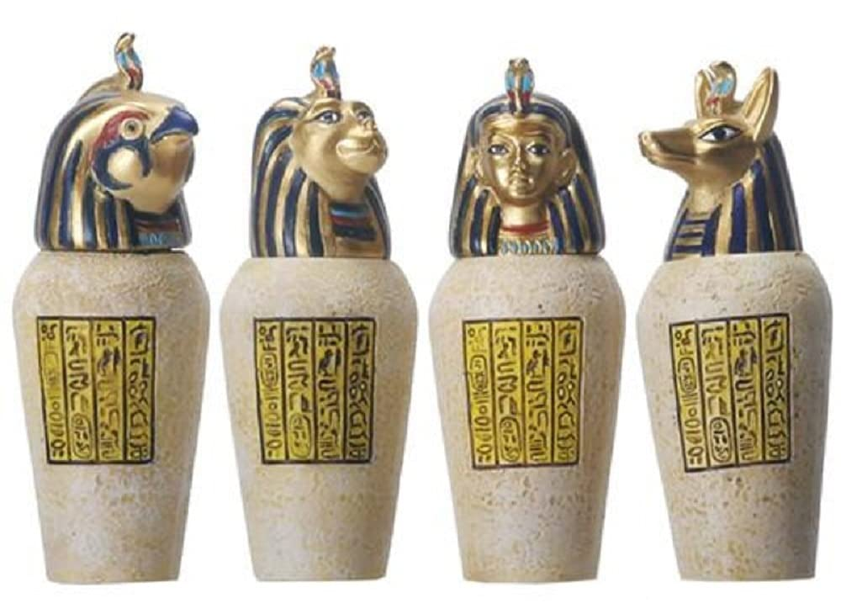

Slide 15
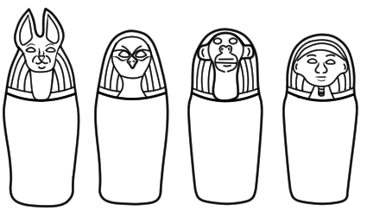
ACTIVITY – Design Canopic Jars

